Slide 1
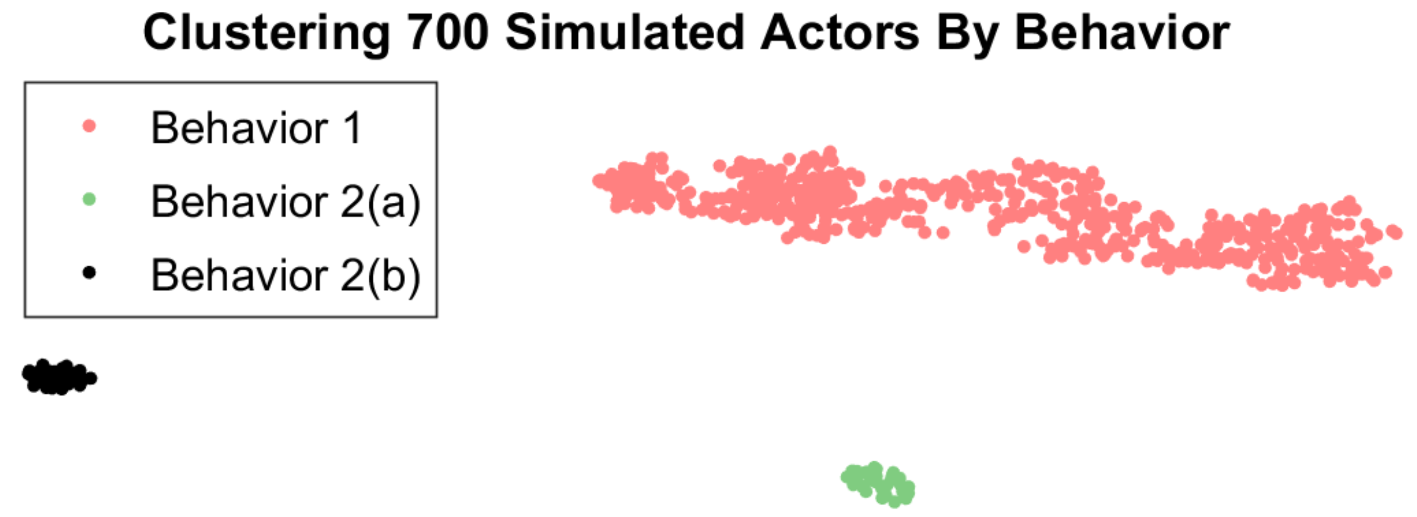
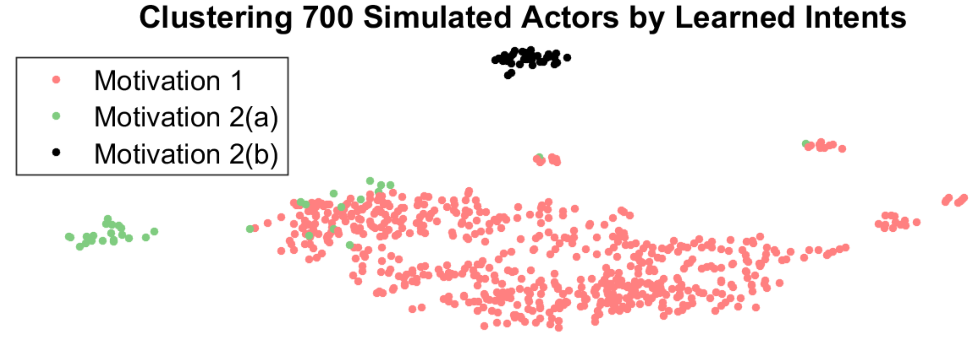
Assistive Agents for Self-Represented Litigants
Mark Rucker and Matthew S. Gerber Daniel Becker
University of Virginia Thomson Reuters
NEED & INDUSTRIAL RELEVANCE
PROJECT GOALS
OBJECTIVES
In America today fewer than one in five low-income individuals have access to the legal help they need¹
To meet this need it is estimated that federal spending on legal aid needs to increase from $300M to $1.6B¹
Meet legal needs without increasing federal spending
Give truly helpful and personalized assistance to SRLs
Connect SRLs with attorneys and courts when needed
Conduct seminal research into digital assistants
Demonstrate usefulness of RL to knowledge services
Extend current research to identify an SRL’s objectives and needs (Rewards) based on their behaviors (Policy)
Assistive Agent
Courts
Attorneys
Self Represented Litigants
Statistical analysis of simulated behavior. There are three clear groups even though two are known to be similar
Analysis of learned intents from simulated behavior. Here we see group 2(a) and (b) begin to look similar despite different behaviors above
Documenting The Justice Gap In America 2009
Legal Services Corporation Funding (www.lsc.gov/lsc-funding)
APPROACH (RESEARCH METHODS)
DELIVERABLES/OUTCOMES
IMPACT
We will work with Thompson Reuter to acquire relevant data sets in order to understand what SRL’s most need
Using this data we will identify the key statistical features that differentiate SRL’s with successful outcomes vs unsuccessful
With these features we will define a state space, action space and reward signal that we can train an assistive agent for
A framework for a continually learning digital assistant
State and action definitions for decisions and planning
Source code for digital assistant used in experiments
Increased successful resolutions for all SRL’s
Increased hourly rate for attorneys to serve
Decrease in the pressure on the US Court System
New model proven which can be used in many industries
Data
MDP
Source

